Slide 1
Introduction to Java Algorithm Session 01
Course : Object Oriented Programming
Effective Period : October 2018

Slide 2
Outline
Introduction
The Java Language Specification, API, JDK, and IDE
Creating, Compiling, and Executing a Java Program
A Simple Java Program (Selection, Repetition)
Programming Style and Documentation
Programming Errors

Slide 3

Java
Java was developed by a team led by James Gosling at Sun Microsystems
Originally called Oak (in 1991)
Design for use in embedded chips in consumer appliance
Renamed Java (in 1995)
Re-design for developing Internet applications

Slide 4
Java Language Specification and API
Java language specification and Java API define the Java standard.
Java language specification is a technical definition of the language that includes the syntax, and semantics of the Java programming language.
The application program interface (API) contains pre-defined classes and interfaces for developing Java programs.
The java language specification is stable, but the API is still expanding.

Slide 5
Java Edition and JRE
Java Edition:
Java Standard Edition (Java SE) To develop client-side applications.
Java Enterprise Edition (Java EE) To develop server-side applications.
Java Micro Edition (Java ME) To develop applications for mobile devices.
Java Runtime Environment (JRE)
A Software that execute Java based application
Java Virtual Machine (JVM) is a collection of programs to execute java bytecode on any computer platform.

Slide 6
JDK
Java Development Toolkit (JDK) consist of set of separate program, each invoked from a command line, for developing and testing Java programs.
Java development tool is a software that provides an Integrated Development Environment (IDE) for rapidly developing Java programs.
Example:
JBuilder by Borland (www.borland.com)
NetBeans Open Source by Sun (www.netbeans.org)
Eclipse Open Source by IBM (www.eclipse.org)
Code Warrior by Metrowerks (www.metrowerks.com)
TextPad Editor (www.textpad.com)
JCreator LE (www.jcreator.com)
JEdit (www.jedit.org)

Slide 7
Most commonly application programs in JDK
Compiler: javac
Interpreter: java
Debugger: jdb
Applet Viewer : appletviewer
Documentation: javadoc
Compressor: jar
Welcome.java
(Java source code file)
Java Compiler
Welcome.class
(Java bytecode executable fle)
JVM
Compiled by
generates
Executed by

Slide 8
Creating, Compiling, Executing
Source code (developed by the programmer)
Create/Modify Source Code
public class Welcome {
Public static void main(String [] args)
{
System.out.println(“Welcome to Java!”);
}
}
Save on the disk
Source Code
Compile Source Code
e.g., javac Welcome.java
Bytecode (generated by the compiler for JVM to read and interpret, not for you to understand)
Stored in the disk
If compilation errors
…
Method Welcome()
0 aload_0
…
Method void main(java.lang.String[])
0 getstatic #2 …
3 ldc #3 <String “Welcome to Java!”>
5 invokevirtual #4
8 return
Bytecode
Run Bytecode
e.g., java Welcome
If runtime
errors or
Incorrect
result
Bina Nusantara
Result

Slide 9
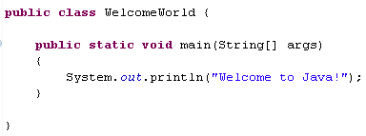
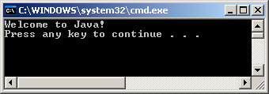
Simple Java Program
Access modifier
Class name
Function name
Class
Block
Statements
Main Method Block
Note: access modifier will be taught in details in the next subject. At First, you just need to apply the public access modifier.

Slide 10
Basic Things to Know Before Writing a Simple Programs

Slide 11
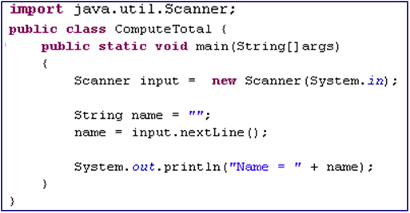
Identifier (1)
What’s called identifier?
Name of things that appear in the program
Identifiers: ComputeTotal, main, input, name

Slide 12
Identifier (2)
Did you know the identifier’s rules?
By Convention,
Consist of letters, digits, underscores, dollar sign
Can not start with digit
Can not use a reserved word, such as if, while, static, etc.
Can be of any length
Note:
descriptive identifier make the code easy to read.

Slide 13

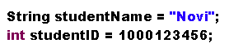
Variables
How to declare a variable?
How to naming a variable?
By convention, the variable name is in lowercase.
If the variable name is consist of more than a word, concatenate them by using underscore symbol (student_name) or capitalize the first letter of each word except the first word (studentName)
How to initializing a variable?
Constant Variable
Permanent data/ data that never changes. Example: Pi = 3.14159
By using final keyword
By convention, constant are named in uppercase
Literal: constant value that appears directly in the program

Slide 14
Assignment Statement and Expression
Assignment statement:
Variable = expression;
Expression: represent a computation involving values, variables, and operators that, taking them together, evaluates to a value.
int x = 1;
X = 5* (3/2) + 3*2;
Comment: Helping a programmer to communicate and understand a program. (internal program documentation)
Notation?
// → line comment
/* … */ → paragraph comment
Assignment Operator

Slide 15
Data Type and Input/Output

Slide 16
Numeric data types
Name | Range | Storage size
byte | -2⁷ (-128) to 2⁷-1 (127) | 8-bit signed
short | -2¹⁵ (-32768) to 2¹⁵-1 (32767) | 16-bit signed
int | -2³¹ (-2147483648) to 2³¹-1 (2147483647) | 32-bit signed
long | -2⁶³ to 2⁶³-1 | 64-bit signed
float | Negative range: -3.4028235E + 38 to -1.4E-45 Positive range: 1.4E-45 to 3.4028235E+38 | 32-bit IEEE 754
double | Negative range: -1.776931348623157E + 308 to -4.9E-324 Positive range: 4.9E-324 to 1.7976931348623157E+308 | 64-bit IEEE 754
List of six numeric data types, their ranges, and their storage sizes (Daniel Y. Liang, Vol 8, 2011, P56)
Notes:
Caution of numeric data type:
For example we have byte where the range is -128 to 127
If you want to store the value -129, it will stored as 127

Slide 17
Character Data Type
The character data type, char, is used to represent a single character.
Unicode and ASCII code
Mapping character to its binary representation is called encoding
Unicode: encoding scheme that is designed as a 16-bit character encoding.
Original Unicode: 16-bit limit (65,536 characters possible)
Supplementary Unicode: Those characters that go beyond the 16-bit limit (extended from the Unicode standard)
ASCII (American Standard Code for Information Interchange)- a 7-bit encoding scheme for representing all uppercase/lowercase letters, digits, punctuation marks, and control characters
Unicode includes ASCII code

Slide 18
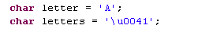
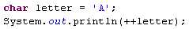
Example of Character Data Type
Both statements assign character A to char variable letter and letters
The increment and decrement operators can also be used on char variables to get the next or preceding Unicode character.
Output: B

Slide 19
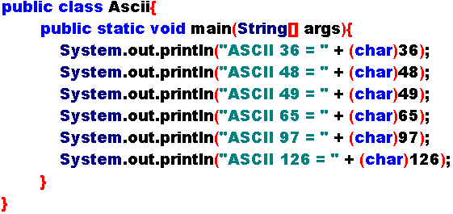
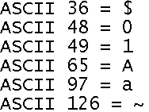
ASCII Sample
Output →

Slide 20
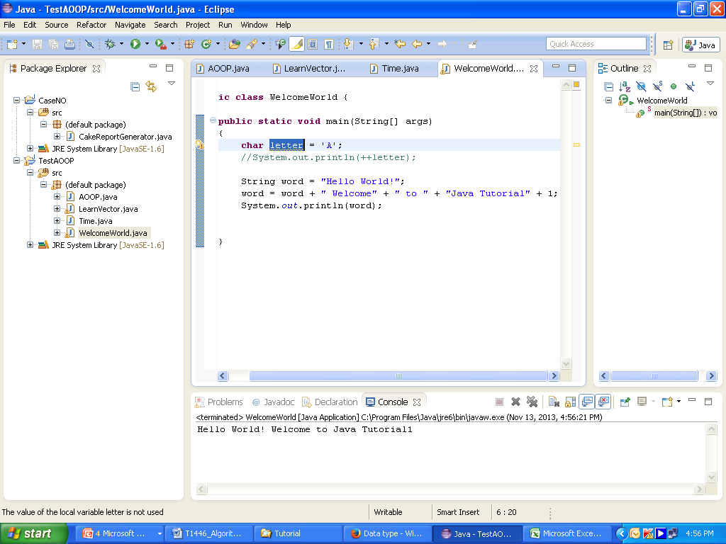
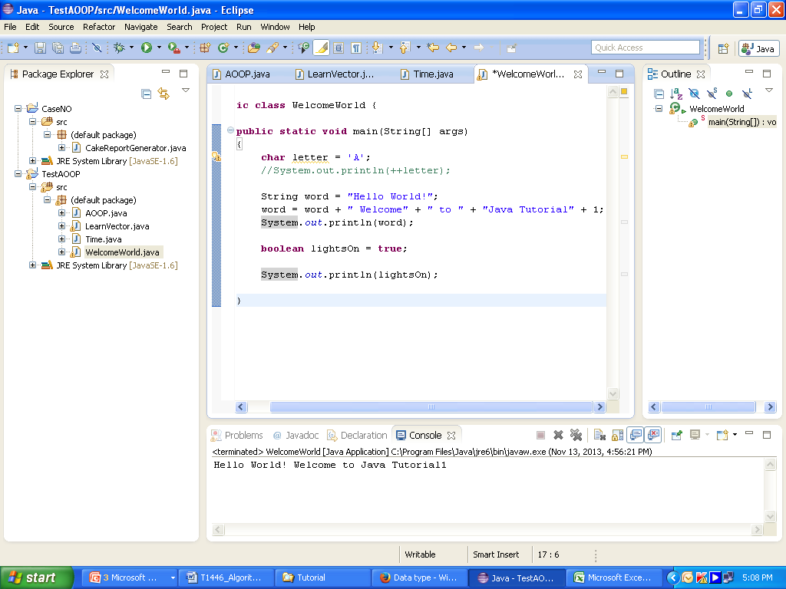
String Types and Boolean Variables
String is used to represent a string of characters
Note: String will be explained more in the next session
Boolean Variables: A variable that holds a Boolean value
Values: true or false
Output →

Slide 21
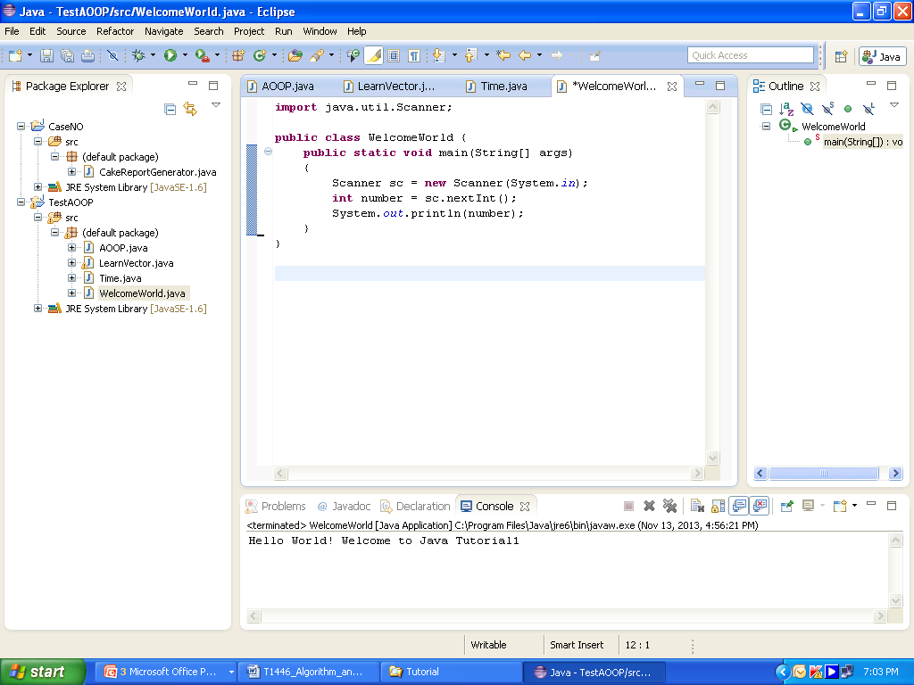
Input in Java Programming
Basic input: From keyboard, How?
Use Scanner class (included in java.util.Scanner)
Steps:
Import the class
Create the object of Scanner class
Utilize the functions provided in the class to get the input from user
Example:
1
2
3

Slide 22
Common used Scanner’s methods
Method | Description
next(); | Input String (word)
nextLine(); | Input String (sentence)
nextByte(); | Input number (byte)
nextShort(); | Input number (short)
nextInt(); | Input number (int)
nextLong(); | Input number (long)
nextFloat(); | Input number (float)
nextDouble(); | Input number (double)

Slide 23
Output
System.out.print
print into console without linefeed (newline).
System.out.println
print into console with linefeed (newline)
System.out.printf
same as System.out.print, supports format output:
Specifier | Description | Example 1 | Output 1 | Example 2 | Output 2
%b | boolean | %6b | ˽false | %-6b | false˽
 |  |  | ˽˽true |  | true˽˽
%c | character | %5c | ˽˽˽˽a | %-5c | a˽˽˽˽
%d | integer | %5d | ˽˽˽69 | %-5d | 69˽˽˽
 |  |  | 1234567 |  | 1E+06
%f | Floating-point | %5.2f | ˽˽3.14 | %-5.2f | 3.14˽˽
 |  |  | ˽20.60 |  | 20.60˽
%e | scientific | %10.2e | ˽˽3.14e+02 | %-10.2e | 3.14e+02˽˽
%s | string | %10s | ˽˽˽˽˽hello | %-10s | hello˽˽˽˽˽
Note : ˽ → space

Slide 24
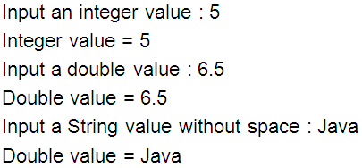
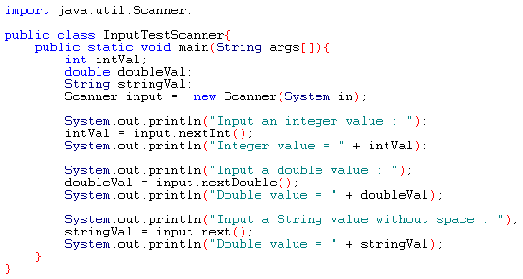
Simple Input/Output Code

Slide 25
Selection and Loop

Slide 26
Selection Statement
Choose actions with two or more alternative courses.
Use conditions, which are Boolean expressions.
Java provides several types of selection statements:
One-way if statements (if without else)
Two-way if statements (if with else)
Nested if statements (if inside if)
switch statements
Conditional expressions
The Statement inside Selection Statements is executed when the condition is fulfilled.

Slide 27
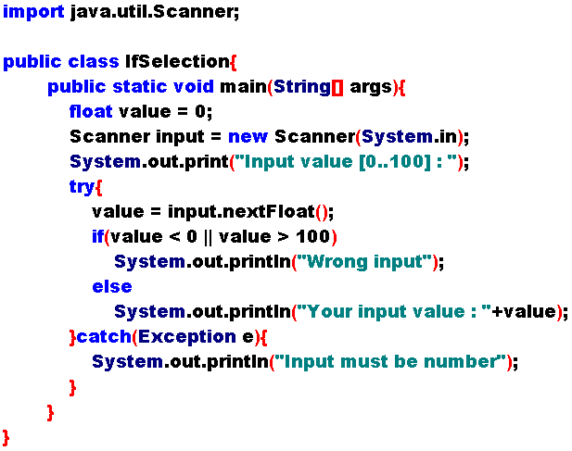
Two-Way if Statements (1)

Slide 28



Two-Way if Statements (2)
Incorrect Output :
Correct Output :
Note:
Try … Catch is useful for exception testing (try) and catching an exception when found (catch).
As depicted in example above, statement inside catch is executed when character or word is entered.
Try .. Catch is explained later at Exception Handling discussion (Session 02)

Slide 29
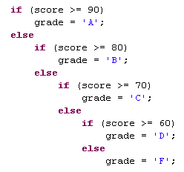
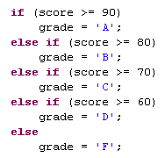
Nested if Statement
Means there is an “if” or an “if-else” inside an “if” or an “if-else”.
There is no limit to the depth of the nesting.
E.g.
Equivalent
This is better

Slide 30
switch Statements Procedures
The switch-expression must yield a value of char, byte, short, or int type.
The value, …, and valueN must have the same data type as the value of switch-expression.
The statements are executed until either break statement or the end of switch statement is reached.
The keyword break is optional.
The default case is optional.
The case statements are checked in sequential order.
Note: They keyword break is explained in detail in the next session

Slide 31
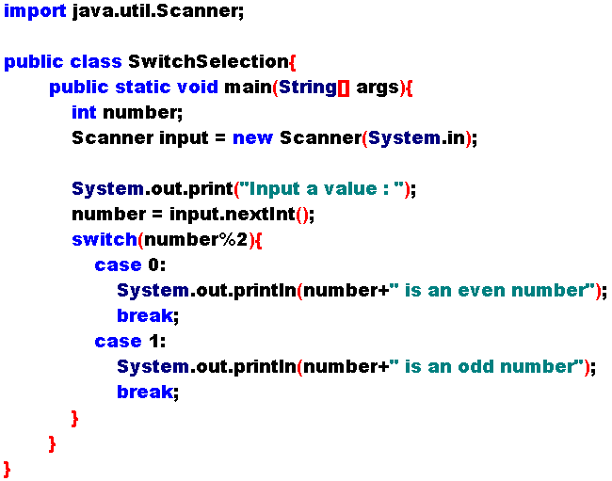


Sample of switch Statement

Slide 32
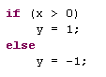
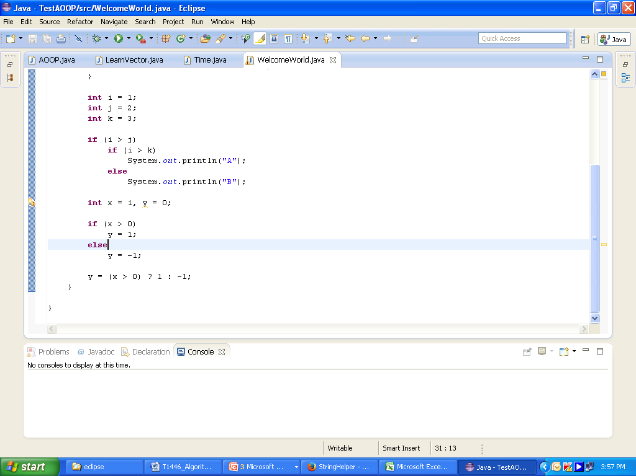
Conditional Expressions
A completely different style, with no explicit if in the statement.
Form?
Boolean-expression ? expression1 : expression2;
E.g.
Use the conditional Expression

Slide 33
Iteration Statement
Controls how many times an operation or a sequence of operations is performed in succession.
Three types of iteration statements:
The while loop (known as counter-controlled loop)
The do-while loop
The for loop
Iteration can be implemented inside iteration (nested)

Slide 34
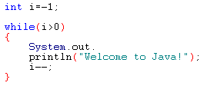
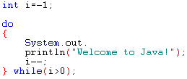
while VS do-while Loop
while
Condition is checked in the beginning of loop (pre-test loop).
do-while
Condition is checked in the last of loop (post-test loop).

Slide 35
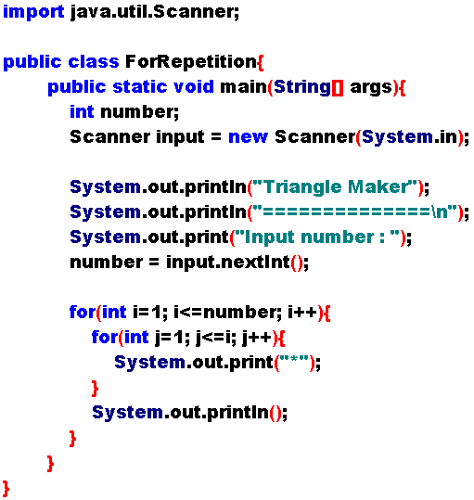
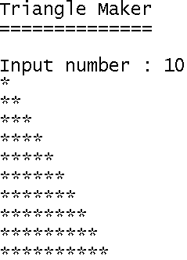
Nested Loops
Create a triangle applying for nested loop.

Slide 36
Jump Operations
Additional control for Looping.
3 jump operations:
break: Stop (and quit) from inner looping,
continue: Stop (not quit) from looping, generally using with if
label: Controlling exit for break and continue
break had been used at switch-case too.

Slide 37
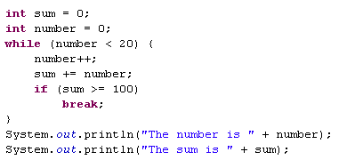
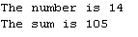
break Operation
Can be used in loop statements to provide additional controls.
Simplify programming in some cases.
Caution!
Overusing or improperly using them, however, can make programs difficult to read and debug

Slide 38
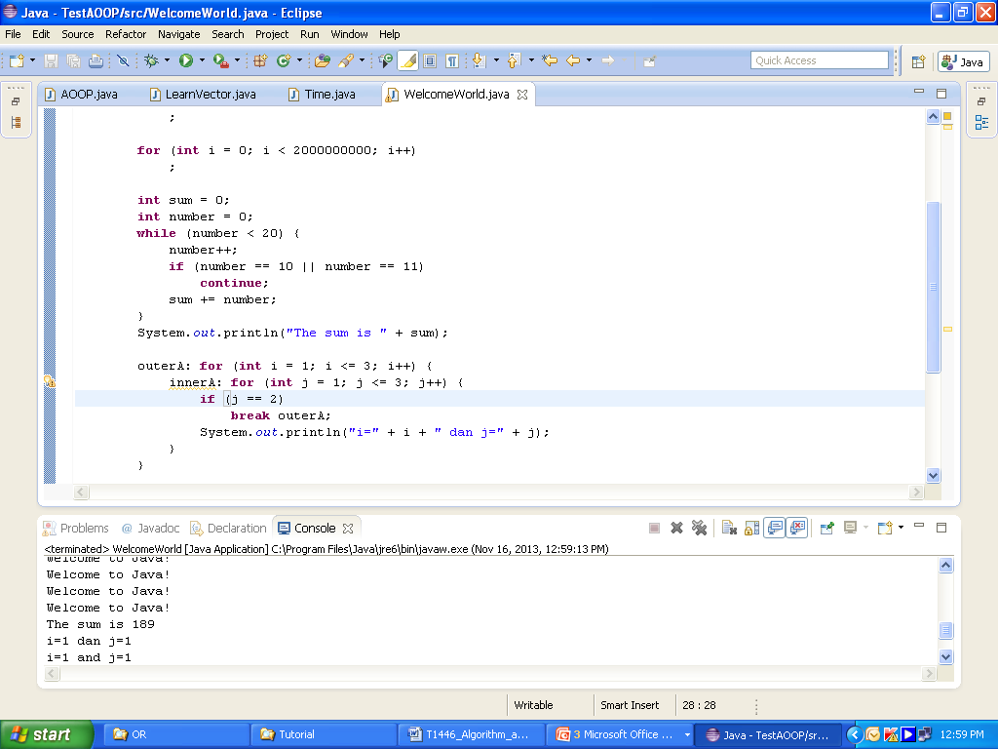
continue Operation
Can also be used in loop statements.
When it is encountered, it ends the current iteration.
Program control goes to the end of the loop body.
Always inside a loop.

Slide 39
break Vs continue
break keyword breaks out of the loop.
continue breaks out of the current iteration in the loop.
Note:
In Java, the break and continue is different from go to statement, which is provided in some programming languages. They operate only in a loop or switch statement.

Slide 40
Programming Style and Documentation
Good programming style and proper documentation make a program easy to read and help programmers prevent errors

Slide 41
Appropriate Comments and Comment Style
Include a summary at the beginning of the program that explains what the program does, its key features, and any unique techniques it uses.
In a long program, you should also include comments that introduce each major step and explain anything that is difficult to read. It is important to make comments concise so that they do not crowd the program or make it difficult to read.

Slide 42
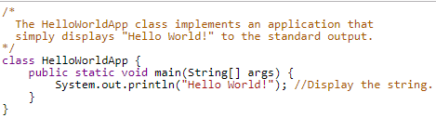
Appropriate Comments and Comment Style
To line comments (beginning with //) and block comments (beginning with /*).
Example:

Slide 43

Proper Indentation and Spacing
A single space should be added on both sides of a binary operator, as shown in the following statement:

Slide 44


Block Styles
There are two popular styles, next-line style and end-of-line style:
Next-line style
End-of-line style
Both are acceptable block styles

Slide 45
Programming Errors
Syntax Errors
Runtime Errors
Logic Errors
Common Errors

Slide 46
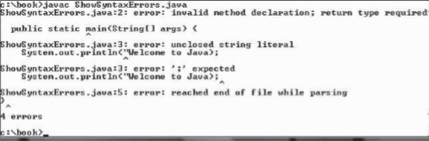
Syntax Errors
Errors that are detected by the compiler are called syntax errors or compile errors
Four errors are reported, but the program actually has two errors:
The keyword void is missing before main in line 2.
The string Welcome to Java should be closed with a closing quotation mark in line 3.

Slide 47

Runtime Errors
Runtime errors are errors that cause a program to terminate abnormally. They occur while a program is running if the environment detects an operation that is impossible to carry out.
Example:

Slide 48

Logic Errors
Logic errors occur when a program does not perform the way it was intended to. Errors of this kind occur for many different reasons.
You will get Fahrenheit 67 degrees, which is wrong. It should be 95.0.
The answer you expect for (9 / 5) calculation is 1,4. However, because both 9 and 5 are integers, (9 / 5) = 1
Therefore, you must change either 9 or 5 into 9.0 or 5.0 (float data type)

Slide 49


Common Errors
Missing a closing brace (})
Missing a semicolon (;)
Type this closing brace right away to
match the opening brace
Missing a
semicolon

Slide 50

Common Errors
Missing quotation marks for strings (“)
Misspelling names are common errors for new programmers.
Java is case sensitive. Misspelling names is a common error for new programmers. For example, the word main is misspelled as Main in the following code:
Missing a quotation mark

Slide 51
Assignment
You are asked to create a simple calculator that can do addition, subtraction, multiplication, division, modulo
Total always appear in the header and the value will change after the calculator is executed
On the first run, the program requires you to input 2 numbers in order to the calculation
On the second run, you only need to input 1 number in order to the calculation
The menu clear total, will reset the total value. The program will change to the first run state.

Slide 52
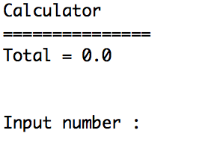
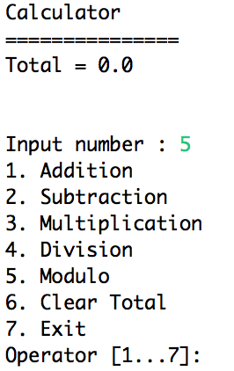
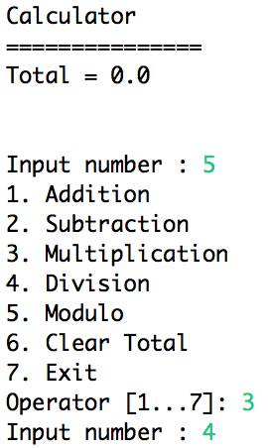
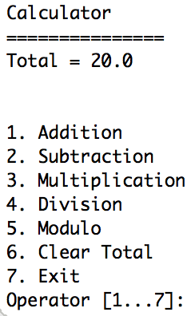
Assignment - Screenshots

Slide 53
References
Daniel Liang, Y., 2015, Introduction to java programming, vol.10, Pearson Education, New Jersey. Chapter 2.
Data Types. http://docs.oracle.com/javase/tutorial/java/nutsandbolts/datatypes.html
String. http://docs.oracle.com/javase/7/docs/api/java/lang/String.html
Composite Data Types. http://remote.science.uva.nl/~heck/JAVAcourse/ch4
Data Type. http://en.wikipedia.org/wiki/Data_type
Primitive Data types. http://java.sun.com/docs/books/tutorial/java/nutsandbolts/datatypes.html
Primitive Data types. http://en.wikipedia.org/wiki/Primitive_type

